Slide 1
BLUE TEAM DEFENSE
“… I always feel like somebody's watching me And I have no privacy “
-Michael Jackson
Created by Skye for UPenn Cybersecurity Bootcamp May 2022

Slide 2

Alerts Implemented on kibana watcher

Slide 3
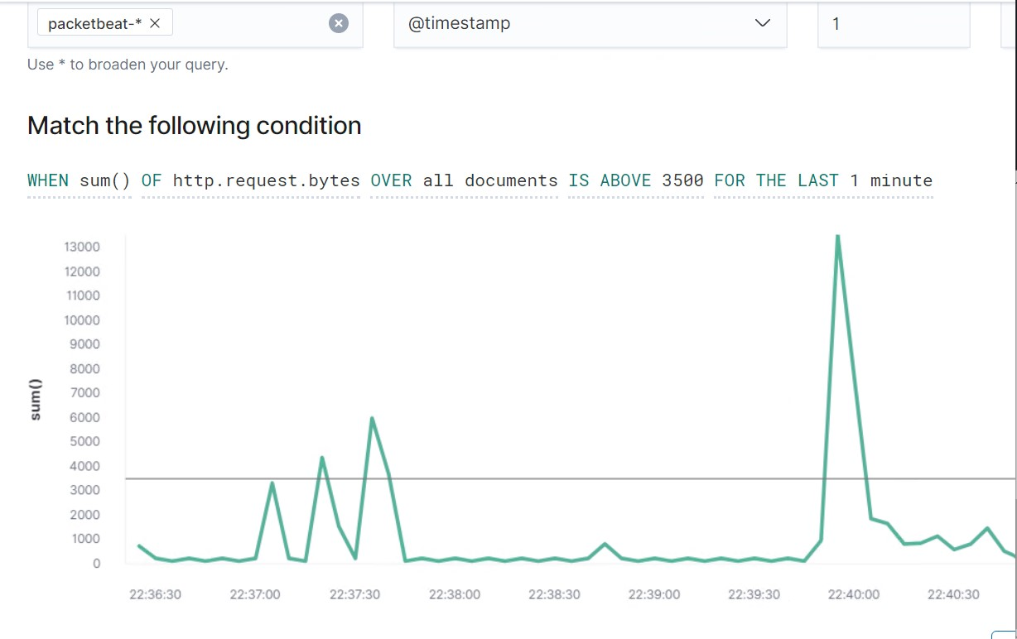
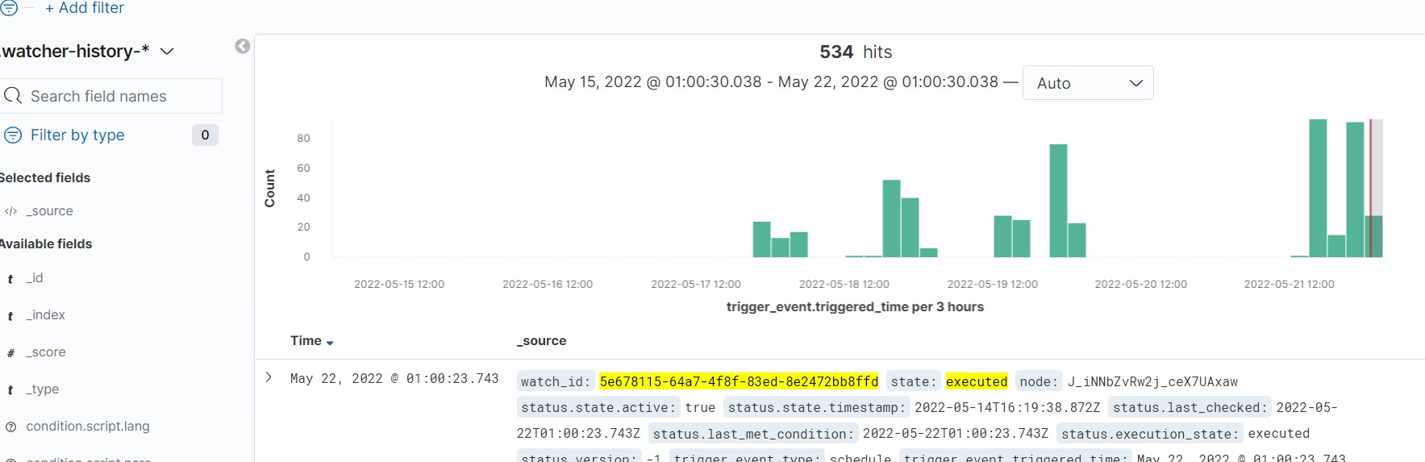
ALERT 1: HTTP Request Size Monitor
THE METRIC: http.request.bytes
THE THRESHOLD: when the sum of the bytes over all documents exceeds 3500 for the last 1 minute
Notes:
Low reliability. It triggered often when there was an attack and when there wasn’t an active attack

Slide 4
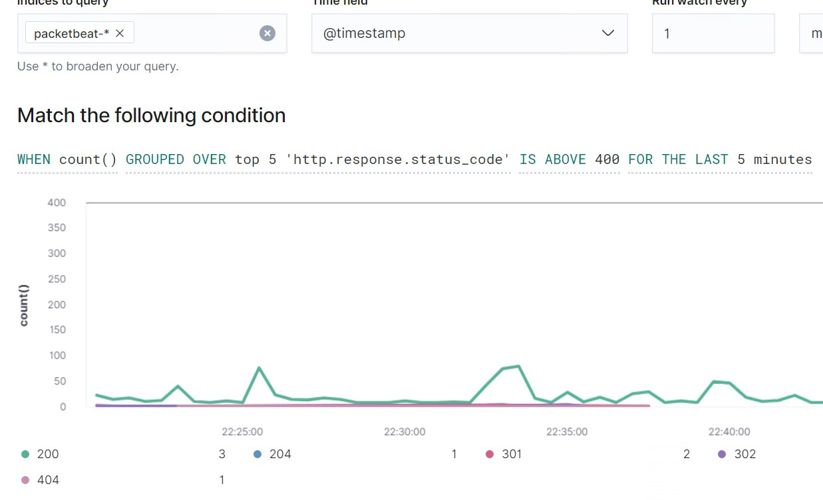
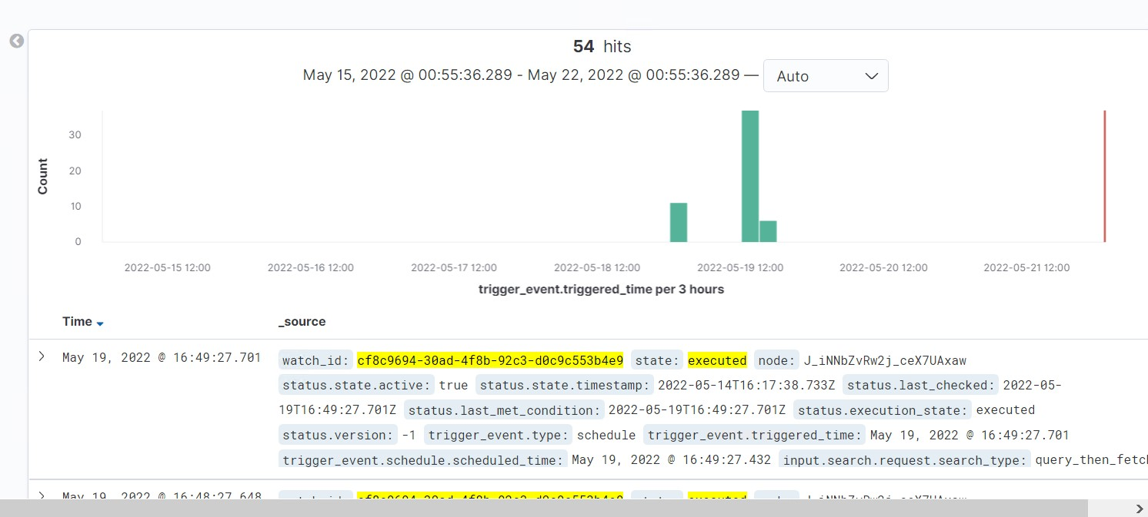
ALERT 2: Excessive HTTP Errors
THE METRIC: http.response.status_code
THE THRESHOLD: when the count of HTTP responses over 400 is grouped over top 5 for the last 5 minutes.
Notes:
Higher reliability. Only triggered during an active attack this week during our exercises

Slide 5
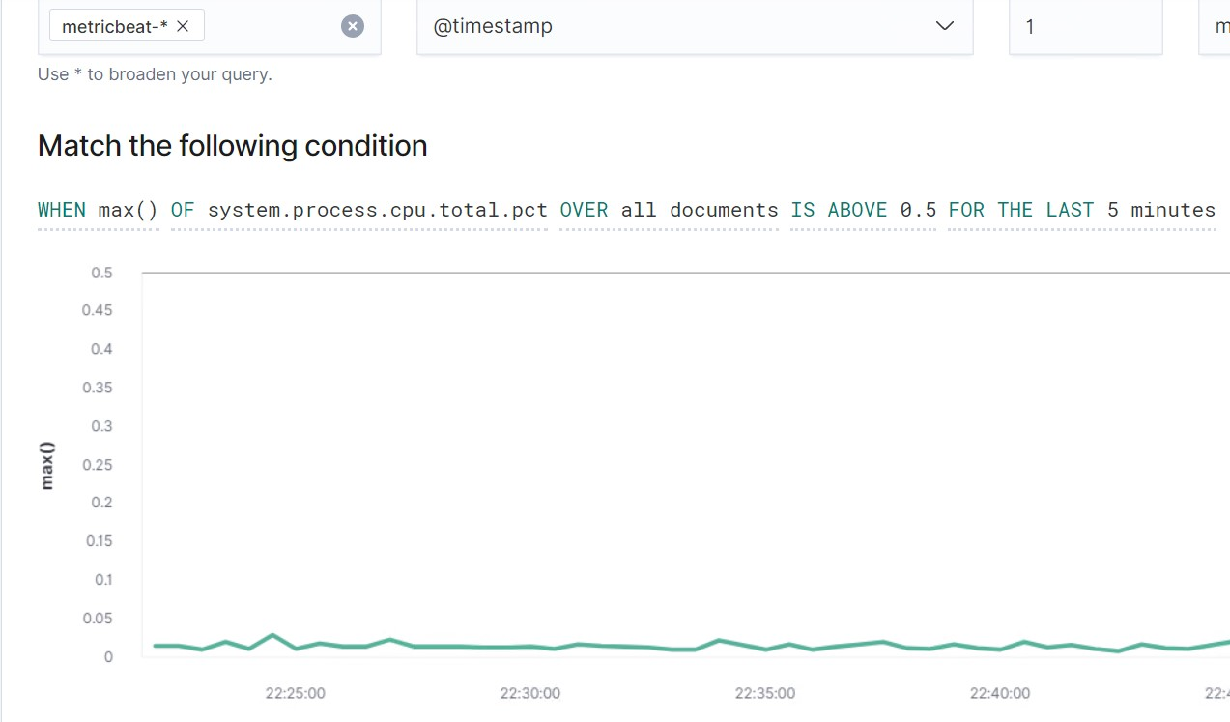
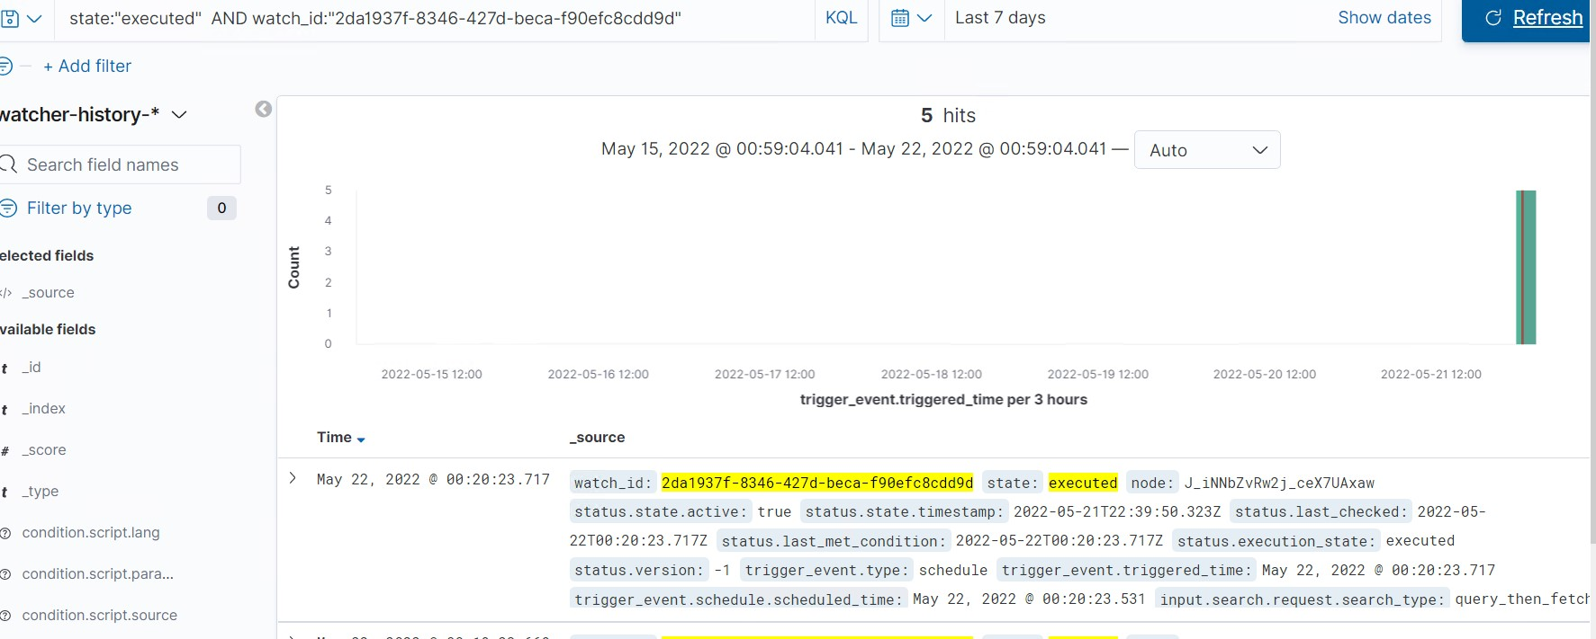
ALERT 3: Excessive CPU Usage
THE METRIC: system.process.cpu.total.pct
THE THRESHOLD: when the percentage of CPU spent by the processes over all documents exceeds 0.5 for the last 5 minutes.
Notes:
CPU usage- moderately reliable. It triggered on simple things like start-up. Excessive usage should be followed no matter what, but maybe increase the trigger threshold.

Slide 6
Other BEATS and MODULES to EXPLORE FOR MORE ALERTS
Using a mysql module through metricbeat to specifically identify Mysql traffic:
https://www.elastic.co/guide/en/beats/metricbeat/7.0/metricbeat-module-mysql.html
Using Indices like auditbeat and logs-endpoint.events to specifically identify NCAT Traffic:
https://www.elastic.co/guide/en/security/current/netcat-network-activity.html

Slide 7

hardening

Slide 8
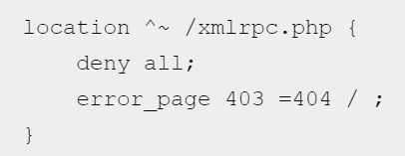
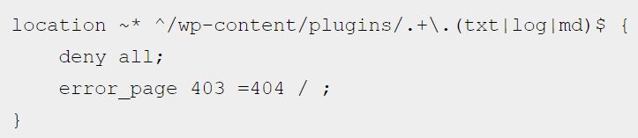
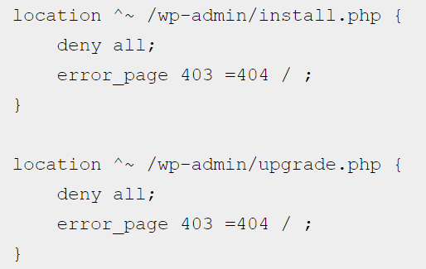
Hardening Against WPScan on Target 1
Modify the NGINX Configurations/ Directives to Block WPScan:
Block access to the xmlrpc.php file in the root folder:
Why it works: It prevents Remote Procedure Call
Block all Access to Install.php and Upgrade.php:
Why it works: It prevents WPScan from enumerating version query strings like Javascript Files.
Block WordPress Plugin Enumeration:
Why it works: It prevents WPScan from knowing the plugin versions to then scan the readme files inside those plugin subfolders.
Notes:
Modifying the NGINX file is the most efficient way to circumvent autoscanning because it will catch request or attempts before they can be processed by WordPress.
XMLRPC- Extensible Markup Language –Remote Procedure Call– this is what executes the remote calls in computer networks using HTTP and the markup language, XML.
WPScan works by scanning or readme files in each of he plugin sub folders– this way WPScan won’t know the Plugin Version
-These files allow WPScan to find out version query strings and javascript files. This will bock all access to the upgrade.php which most likely will need to be accessed in the future– so it isn’t a set it and forget it– it will need to be adjusted when access is necessary.
Useful source:https://shift8web.ca/2019/01/how-to-block-your-wordpress-site-from-being-scanned-by-wpscan-with-nginx/

Slide 9
Hardening Against Unauthorized Access to MySQL on Target 1
Secure the wp-config-file by:
Using newly generated Secret Keys
Moving the wp-config.php file to somewhere other than the root folder of the site
Block access to the wp-config.php file by creating an htaccess file inside the same directory
How to: First create the .htaccess file (You might have to start with a htaccess.txt file then you would change it to a .htaccess file after editing.) and then edit the file to include:
1 <files wp-config.php> 2 order allow,den 3 deny from all 4 </files>
Why it works:
These techniques all harden the accessibility of the wp-config file. If an attacker cannot access the wp-config.php, they would not be able to see sensitive data saved there. In our case, the red team was able to view the username: root and the password: R@v3nSecurity and this is what gave us access to MySQL!
Notes:
What allowed the red team to access MySQL was accessing sensitive data off of the wp-config file. As such we want to secure that file and its contents.
Useful Resource:https://webdesign.tutsplus.com/tutorials/how-to-secure-your-wordpress-wp-configphp--cms-27737
Why update/change your Secret Keys? Because changing credentials makes it harder for hackers to break through your website’s security. It is good practice like changing passwords. Wordpress uses salts and security keys to secure your login information and these being known to attackers can allow them to hijack the browser’s cookies.
By default the wp-config file sits in the root folder of the website which is inside the public HTML folder if the site is on the main domain. Wordpress allows you to move it up one level so it no longer sits in a public folder.
Useful Resource: https://kinsta.com/knowledgebase/wordpress-salts/

Slide 10

Hardening Against Weak Passwords On Target 1
Enact a Strong Password Policy:
Require Complexity– length and varied types of characters
Require Changes/Updates to Passwords on a set schedule
Use a custom implementation of password hashing inside the wp_users file:
Change the default (MD5 or SHA1) hashes with a more complex hash style using an “off-the-shelf” solution like password_hash():
Why it works:
According to CompTIA, one of the easiest ways for a password to be compromised is simply by guessing it. That is exactly what the Red Team did when they guessed the credentials for the user: michael to be the password: michael. A strong password policy for users would mitigate that risk.
When the user credentials were found in the wp_users file during the MySQL session, they were in a form that was easily broken in minutes by the service John the Ripper. Stronger password hashes would prevent that ease of access.
Notes:
Since the password hashing/checking system in WordPress is PLUGGABLE, it can be replaced with a custom implementation. This is not usually done, however, because most rely on defaults for better compatibility.
Useful Resource: https://www.php.net/manual/en/function.password-hash.php
Useful Resource:https://wordpress.stackexchange.com/questions/252872/protect-passwords-in-wp-users-with-stronger-protection-than-md5

Slide 11
Hardening Against Brute Force Attacks On Target 1 And 2
Install a WordPress Firewall Plugin at the DNS or Application Level
Why it works: A firewall service will filter and block nefarious traffic from accessing the site.
Make Sure WordPress is up to date:
Run wp core version to verify current WP Version
Then Run wp core update to update to the latest version
Why it works: Having an updated WordPress Installation should provide security from older known vulnerabilities that have been patched in the most recent version of WordPress.

Slide 12
Hardening Against .php Uploads Through Local File Inclusion On Target 2
Require Authentication to upload files.
Examine the code used to upload files to make sure that the ‘move_uploaded_files()’ function will not be executed unless it is being done by an authenticated user.
Block access to PHP files in a .htaccess file configuration:
Inside the folder where access needs to be blocked:
<Files ^(*.php|*.phps)>
order deny,allow
deny from all
</Files>
Why it works:
‘move_uploaded_files()’ is the function that usually handles uploads like a PHP Shell. By finding, examining, and strengthening each application code that calls for ‘move_uploaded_files()’ upload access can be mitigated.
Notes:
Shell upload vulnerabilities allow an attacker to upload a malicious PHP file. This allows the attacker to control the web server. Local File inclusion occurs when the application uses the path to a file as input.
Useful Resource: https://blog.securityinnovation.com/blog/2014/01/preventing-shell-upload-vulnerabilities-in-php.html
Useful Resource: https://www.acunetix.com/blog/articles/local-file-inclusion-lfi/

Slide 13

Hardening Against GoBuster Web Server Enumeration On Target 2
Using mod_rewrite on Apache to rewrite anything that looks like a request for a directory into a request for a file that doesn’t exist:
Why it works: Since directory-enumeration attacks like GoBuster rely on searching a site from a file of popular director names, it can be assumed that any directory that does not return a 400 HTTP Response code exists.
By configuring Apache to rewrite anything that looks like a request for a directory to instead look like a request for a file that doesn’t exist, then the response should be a 400+ error which would make the attacker think that the file does not exist.
Notes:
I found this idea on pentestmonkey.net. This is an interesting concept, and I am not sure it would work in this Apache Web Server running WordPress, but I do believe it is worth exploring as a type of hardening.
It is notable that it will only work on attacks that place a forward-slash at the end of their directory name query.
Useful Resource: https://pentestmonkey.net/blog/direnum

Slide 14

Implementing patches
We are going to fix this leaking web server!

Slide 15
Implementing patches with ansible
Ansible containers and automation services like Cron can be vital in the deployment, updating, and hardening of a Word Press web server.
Publicly available Ansible Playbooks:
For WordPress:
https://github.com/do-community/ansible-playbooks/tree/master/wordpress-lamp_ubuntu1804
For Apache2
https://github.com/do-community/ansible-playbooks/tree/master/apache_ubuntu1804
Keeping Apache and WordPress Up to Date, in general:
For Apache:
$ apache2 –v
$ sudo add-apt repository ppa:ondrej/apache2
$ sudo apt update
$sudo apt install apache2
$ sudo systemctl restart apache2
For WordPress:
$ wp core version
$ wp core update
Notes:
https://launchpad.net/~ondrej/+archive/ubuntu/apache2
Is a common though untrusted package
While an Ansible container hasn’t been provided to us, there are free and available playbooks for all sorts of jobs.
These containers can be modified to harden the web servers

